Slide 1
UML Activity Diagrams
Prepared by:
Dr. Muhammad Iqbal Hossain
Assistant Professor,
Dept. of CSE, Brac University
Prepared by: Dr. Muhammad Iqbal Hossain

Slide 2
OUTLINE
Introduction
Activity Diagrams - notation
How to apply activity diagrams
Guidelines
Examples
Prepared by: Dr. Muhammad Iqbal Hossain

Slide 3

What is an Activity Diagram?
An Activity Diagram is one of the Behavior diagrams.
Activity modelling is the sequence and conditions for coordinating lower-level behaviors, rather than which classifiers own those behaviors.
These are commonly called control flow and object flow models.
A UML Activity Diagram shows sequential and parallel activities in a process.
Useful for modelling:
  Business processes
  Workflows
  Data flows
  Complex algorithms
Prepared by: Dr. Muhammad Iqbal Hossain

Slide 4


Initial and Final Nodes
Initial Node:
  An initial node is a control node at which flow starts when the activity is invoked.
  An activity may have more than one initial node.
Final Node:
  An activity may have more than one activity final node;
  the first one reached stops all flows in the activity.
Prepared by: Dr. Muhammad Iqbal Hossain

Slide 5
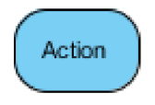
Action
Action:
  An action represents a single step within an activity that is not further decomposed within the activity.
  An activity represents a behavior that is composed of individual elements that are actions.
  An action is simple from the point of view of the activity containing it, but may be complex in its effect and not be atomic.
  An activity can be reused in many places, whereas an instance of an action is only used once at a particular
  An action will not begin execution until all of its input conditions are satisfied.
Prepared by: Dr. Muhammad Iqbal Hossain

Slide 6


Merge and Decision Nodes
Merge Node:
  A merge node is a control node that brings together multiple alternate flows.
  It is not used to synchronize concurrent flows but to accept one among several alternate flows.
  A merge node has multiple incoming edges and a single outgoing edge.
Decision Node:
  A decision node accepts tokens on an incoming edge and presents them to multiple outgoing edges.
  Which of the edges is actually traversed depends on the evaluation of the guards on the outgoing edges.
Prepared by: Dr. Muhammad Iqbal Hossain

Slide 7


Join and Fork Nodes
Join Node:
  A join node is a control node that synchronizes multiple flows.
  A join node has multiple incoming edges and one outgoing edge.
Fork Node:
  A fork node is a control node that splits a flow into multiple concurrent flows.
  A fork node has one incoming edge and multiple outgoing edges.
Fork Node
Join Node
Prepared by: Dr. Muhammad Iqbal Hossain

Slide 8
Business Process Modelling
Example: Parcel shipping
  The process of shipping a parcel is non-trivial; there are many parties involved (customer, driver,. . . ) and many steps.
  The process can be captured by a Use Case diagram, but activity diagrams are great example of “a picture being worth a thousand words”.
  Object nodes are useful for illustrating what is moving around.
Prepared by: Dr. Muhammad Iqbal Hossain

Slide 9
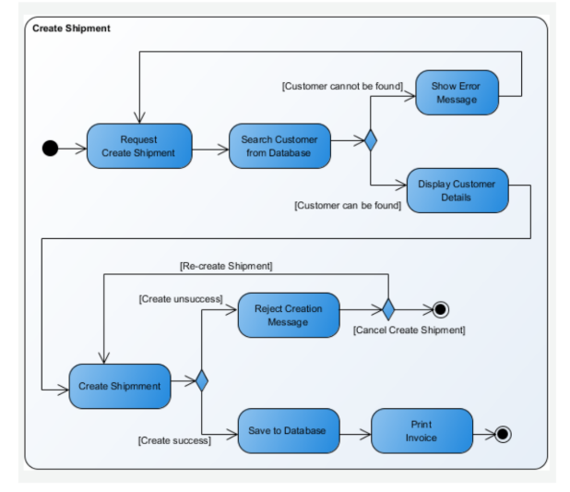
Activity Diagram Parcel shipping
Prepared by: Dr. Muhammad Iqbal Hossain

Slide 10
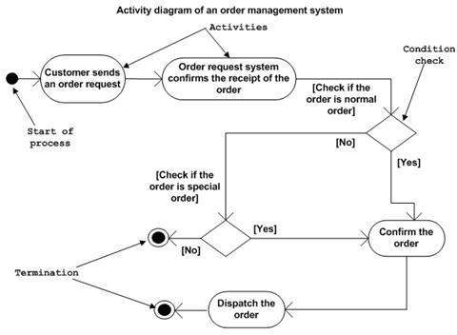
Activity Diagram of order management system
Prepared by: Dr. Muhammad Iqbal Hossain

Slide 11
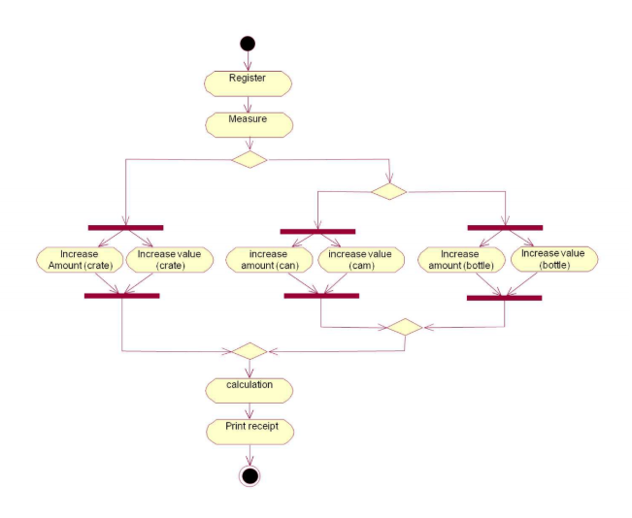
More Examples: Recycling Activity Diagrams
Prepared by: Dr. Muhammad Iqbal Hossain

Slide 12
Swimlanes
Swimlanes (or activity partitions) indicate where activities take place.
Swimlanes can also be used to identify areas at the technology level where activities are carried out
Swimlanes allow the partition an activity diagram so that parts of it appear in the swimlane relevant to that element in the partition
Prepared by: Dr. Muhammad Iqbal Hossain

Slide 13
Swimlanes
Partitions may be constructed on the basis of:
  the class and actor doing the activity
  Partitioning by class and actor can help to identify new associations that have not been documented in the class model
  the use case the activity belongs to
  Partitioning by use cases can help document how use cases interact
Prepared by: Dr. Muhammad Iqbal Hossain

Slide 14
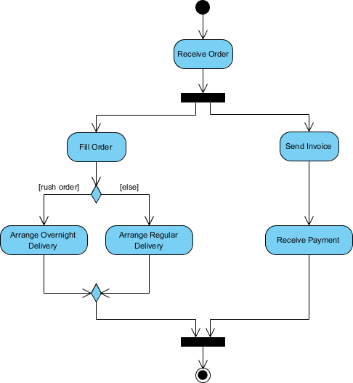
Example Activity
Process Order - Problem Description
Once the order is received, the activities split into two parallel sets of activities. One side fills and sends the order while the other handles the billing.
On the Fill Order side, the method of delivery is decided conditionally. Depending on the condition either the Overnight Delivery activity or the Regular Delivery activity is performed.
Finally the parallel activities combine to close the order.
Prepared by: Dr. Muhammad Iqbal Hossain

Slide 15
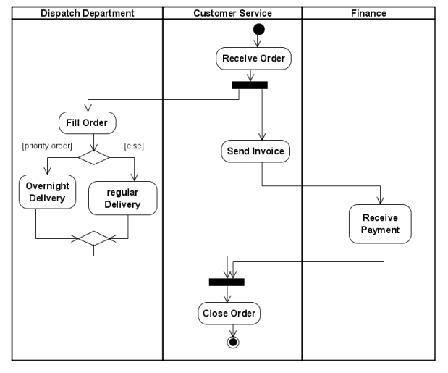
Example Swimlanes
Prepared by: Dr. Muhammad Iqbal Hossain

Slide 16
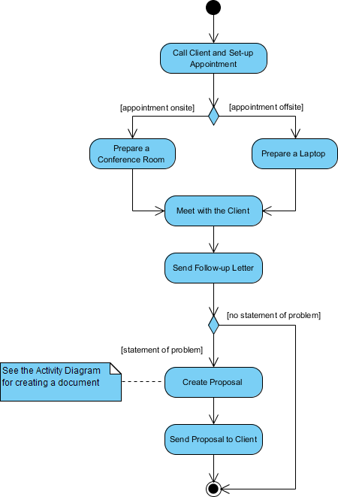
Prepared by: Dr. Muhammad Iqbal Hossain

Slide 17
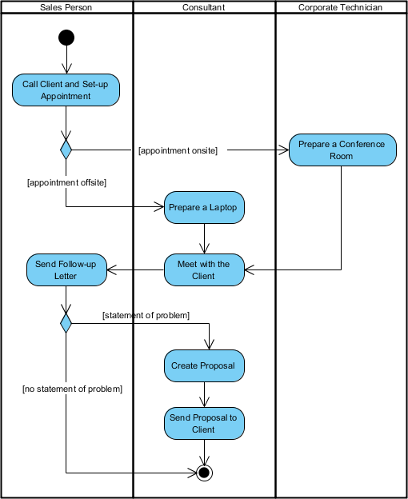
Prepared by: Dr. Muhammad Iqbal Hossain

Slide 18
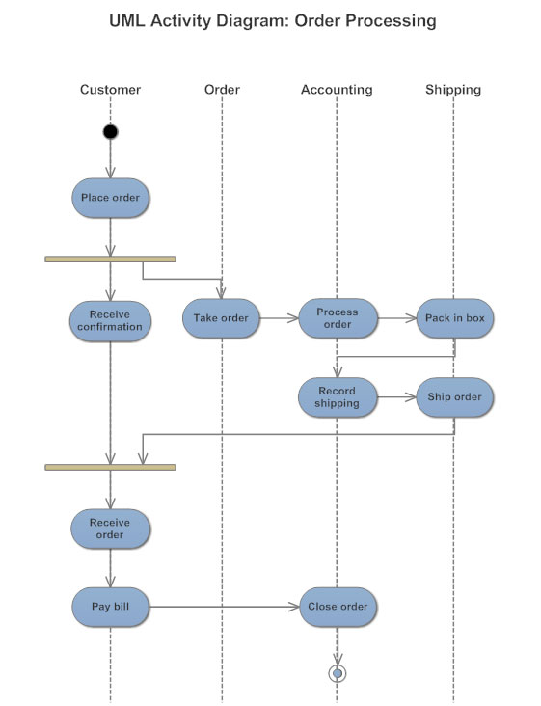
Prepared by: Dr. Muhammad Iqbal Hossain

Slide 19
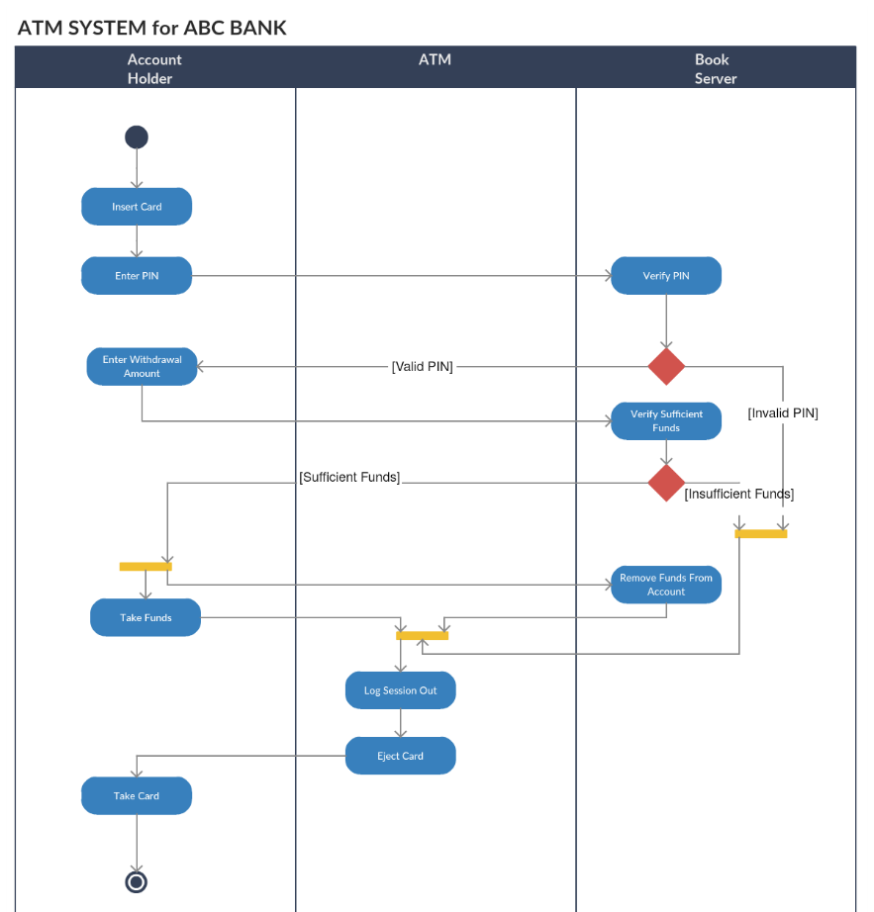
Prepared by: Dr. Muhammad Iqbal Hossain

Slide 20
UML Sequence diagram
Prepared by:
Dr. Muhammad Iqbal Hossain
Assistant Professor,
Dept. of CSE, Brac University

Slide 21
Sequence Diagram(make a phone call)
Caller
Phone
Recipient
Picks up
Dial tone
Dial
Ring notification
Ring
Picks up
Hello
Prepared by: Dr. Muhammad Iqbal Hossain

Slide 22
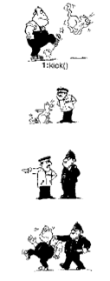
Person kicks the cat
Cat reports to inspector
Inspector reports to Policeman
Policeman arrests person
Prepared by: Dr. Muhammad Iqbal Hossain

Slide 23
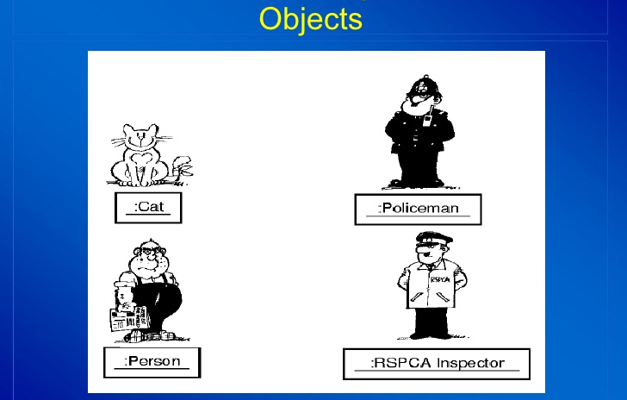
Prepared by: Dr. Muhammad Iqbal Hossain

Slide 24
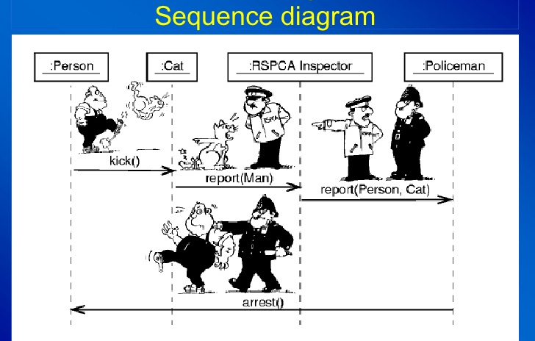
Prepared by: Dr. Muhammad Iqbal Hossain

Slide 25
Sequence Diagrams
Dynamic model
Illustrate the Actors that participate in a use-case
Show the sequence of messages that pass between objects for a particular use-case over time
  Example: order food, change tv channel
It models a single scenario executing in the system
Prepared by: Dr. Muhammad Iqbal Hossain
Notes:
A sequence diagram simply depicts interaction between objects in a sequential order i.e. the order in which these interactions take place.

Slide 26
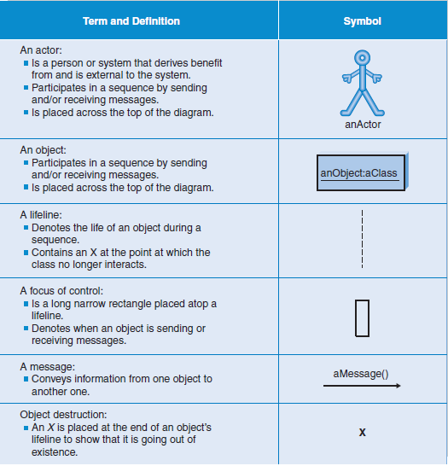
Prepared by: Dr. Muhammad Iqbal Hossain

Slide 27
Sequence Diagrams – Object Life Spans
Creation
  Create message
  Object life starts at that point
Activation
  Symbolized by rectangular stripes
  Place on the lifeline where object is activated.
  Rectangle also denotes when object is deactivated.
Deletion
  Placing an ‘X’ on lifeline
  Object’s life ends at that point
A
Create
B
Activation bar
X
Return
Deletion
Lifeline
Prepared by: Dr. Muhammad Iqbal Hossain

Slide 28
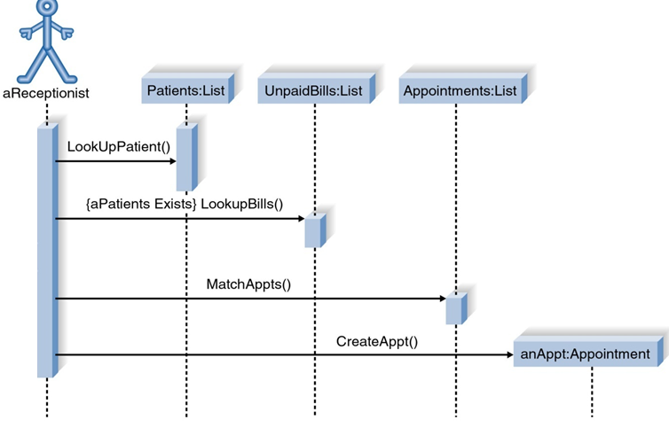
Sequence Diagram for Patient appointment Use Case
Prepared by: Dr. Muhammad Iqbal Hossain

Slide 29
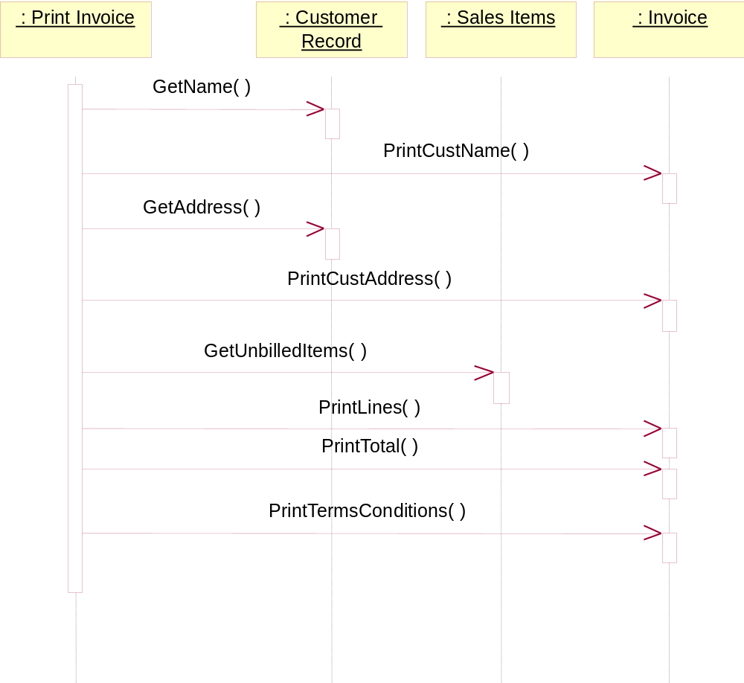
Sequence Diagram for Print Invoice use case
Prepared by: Dr. Muhammad Iqbal Hossain

Slide 30
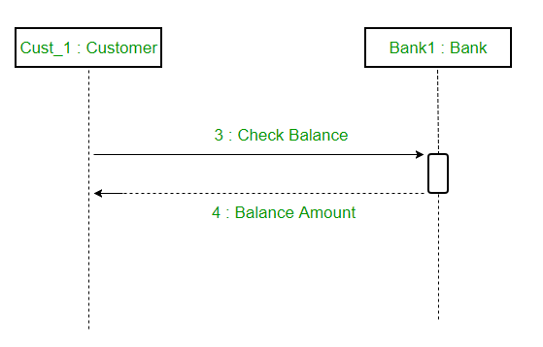
Reply-Response Messages
Prepared by: Dr. Muhammad Iqbal Hossain

Slide 31
Building a Sequence Diagram
Determine the context of the sequence diagram
Identify the participating objects
Set the lifeline for each object
Add messages
Add execution occurrence on each object’s lifeline
Validate the sequence diagram
Prepared by: Dr. Muhammad Iqbal Hossain

Slide 32
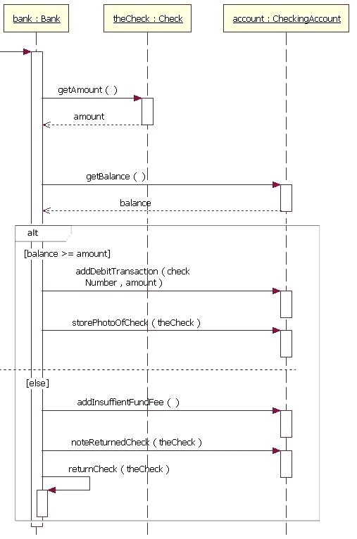
Alternate box
Prepared by: Dr. Muhammad Iqbal Hossain

Slide 33
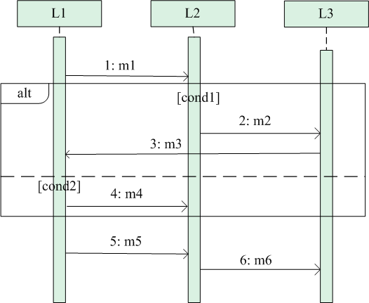
Alternate / if-else scenario in sequence diagram
Upper or lower part will work at a time.
Based on the condition.
Prepared by: Dr. Muhammad Iqbal Hossain

Slide 34
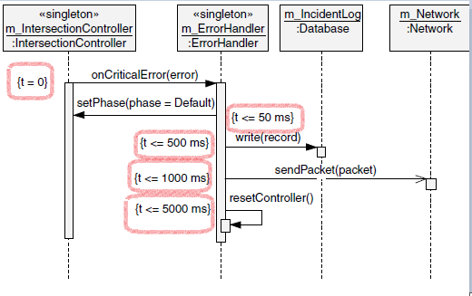
Multiple If-else condition
Prepared by: Dr. Muhammad Iqbal Hossain

Slide 35
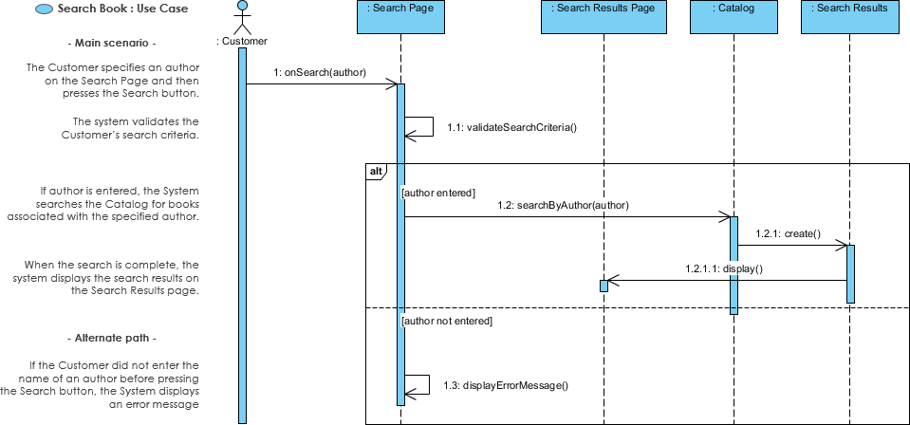
Sequence Diagram for search book Use Case
Prepared by: Dr. Muhammad Iqbal Hossain

Slide 36
Thanks
Prepared by: Dr. Muhammad Iqbal Hossain

